Slide 1
Multiplexer (Data Selectors)
The term Multiplexer means many into one.
Multiplexing is the process of transmitting a large number of information over a single line.
A Digital Multiplexer (MUX) is a combinational Circuit that select one digital information from several sources and transmits the selected information on a single output line.
A Multiplexer is also called a Data Selector.
The Multiplexer has several data input line and a single output line.

Slide 2
Cont.
MUX directs one of the inputs to its output line by using a control bit word (selection line) to its select lines.
Multiplexer contains the followings:
data inputs
selection inputs
a single output
Selection input determines the input that should be connected to the output.
The multiplexer acts like an electronic switch that selects one from different.

Slide 3
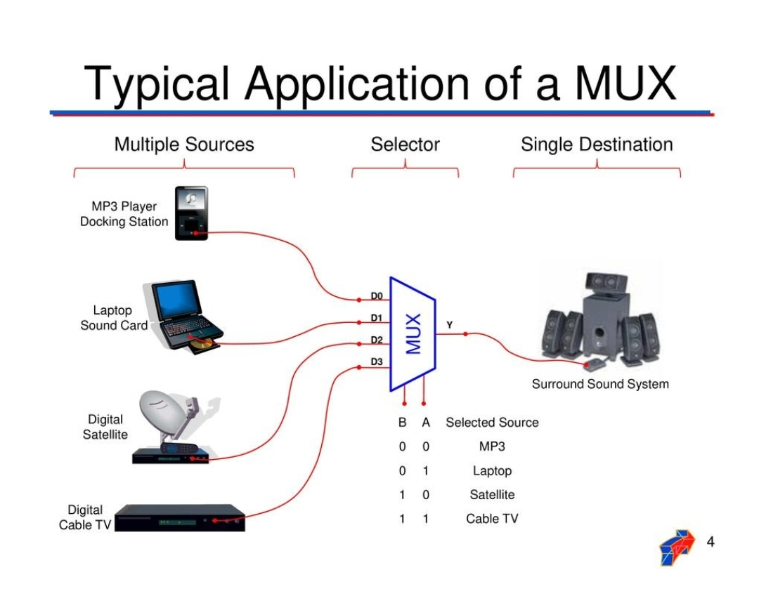

Slide 4
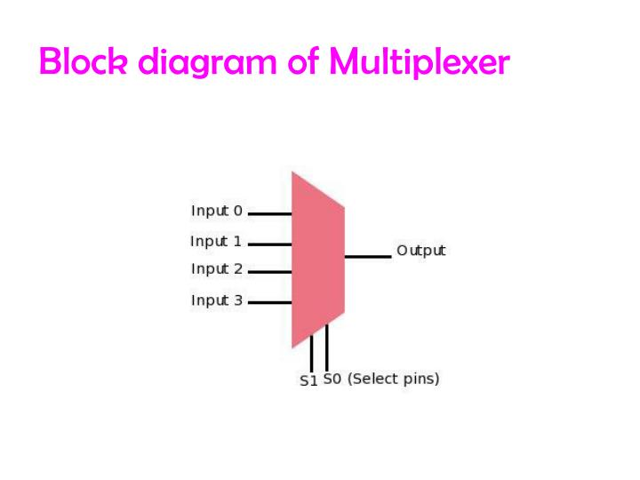

Slide 5
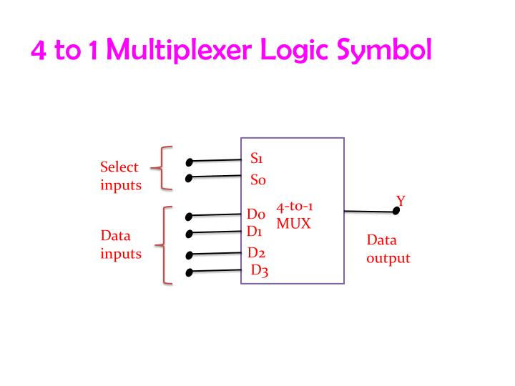

Slide 6
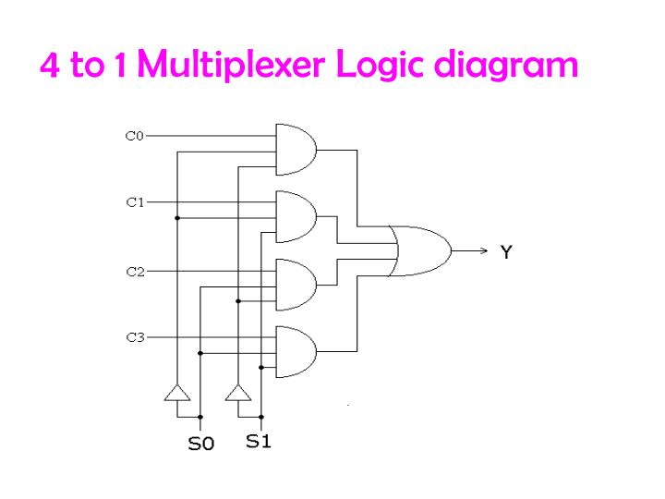

Slide 7
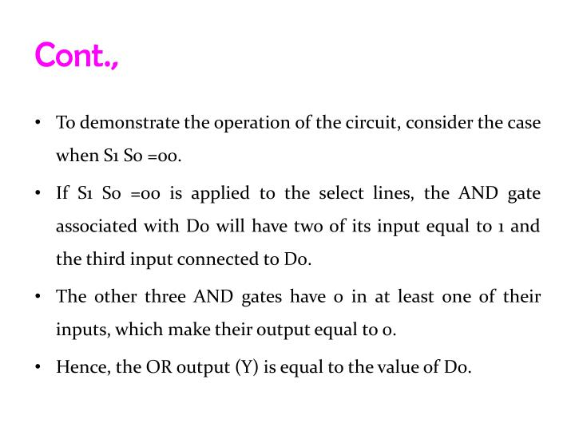

Slide 8
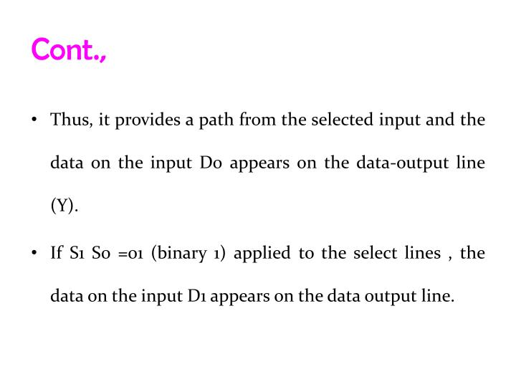

Slide 9
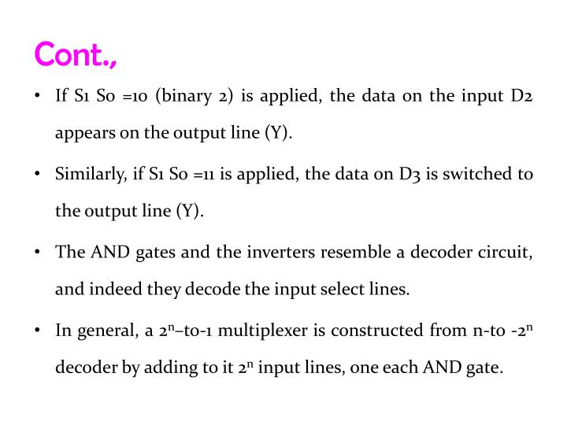

Slide 10
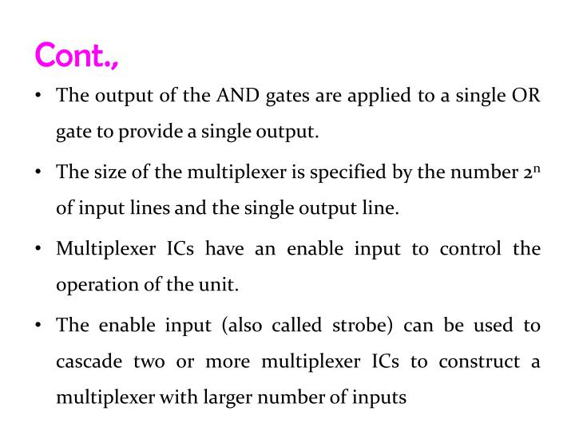

Slide 11
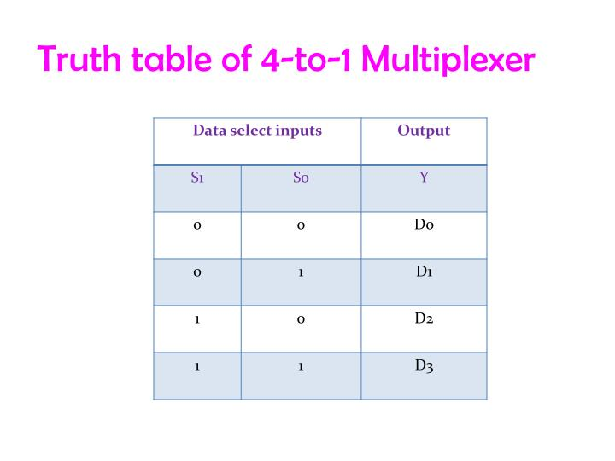

Slide 12
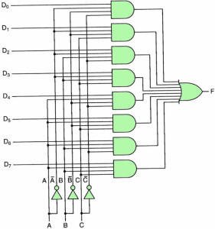
8-1 Multiplexer Circuit

Slide 13
De-Multiplexer
The De-Multiplexer is a combinational logic circuit that performs the reverse operation of multiplexer (Several output lines, one input line).
De -Multiplexer means one to many. A De-Multiplexer is a circuit with one input and many output. By applying control signal, we can steer any input to the output. Few types of De -Multiplexer are 1-to 2, 1-to-4, 1-to-8 and 1-to 16 De -Multiplexer .
De-Multiplexer is the process of taking information from one input and transmitting the same over one of several outputs.

Slide 14
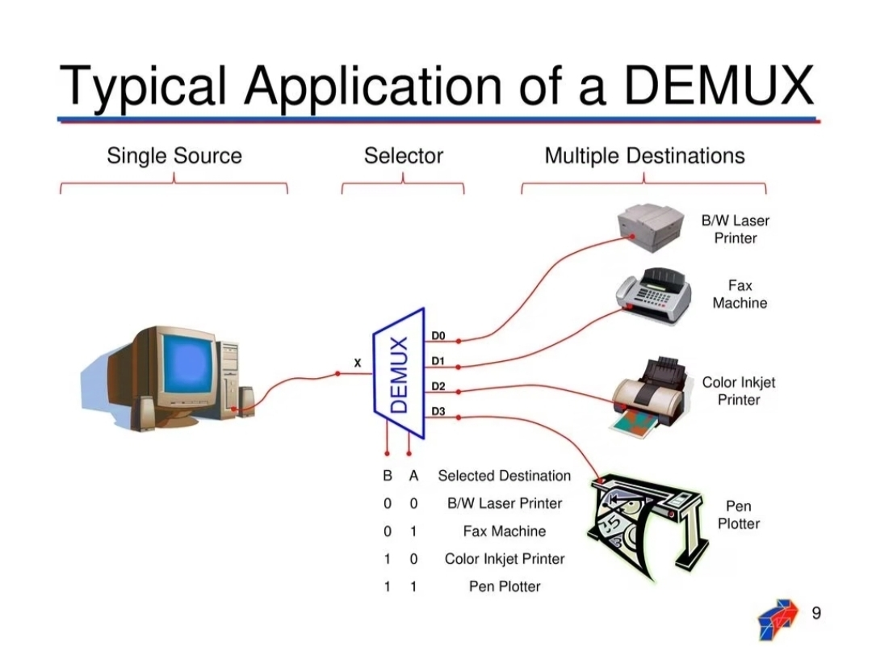

Slide 15
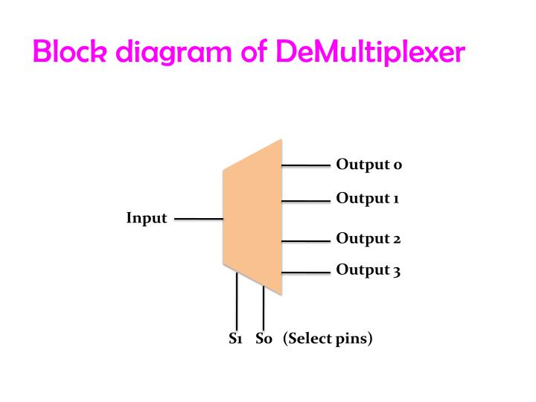

Slide 16
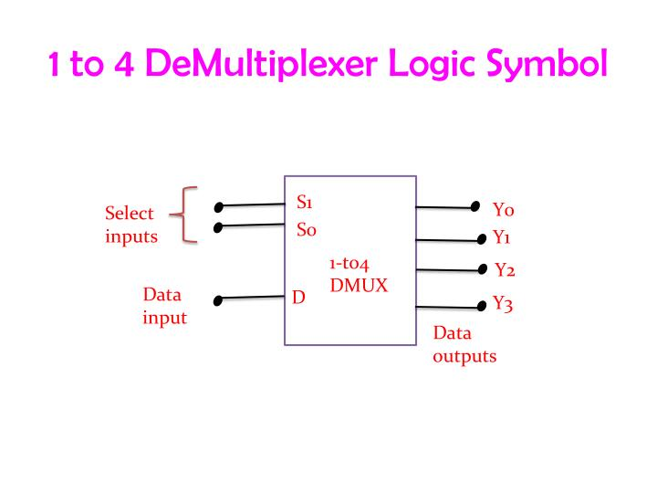

Slide 17
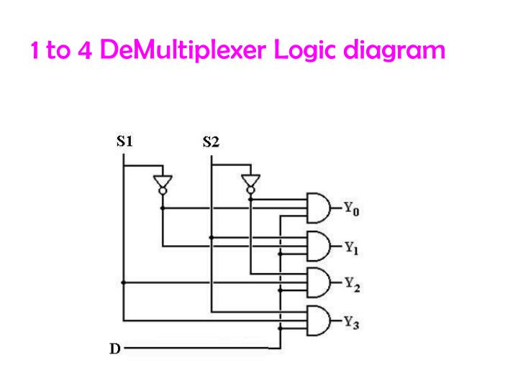

Slide 18
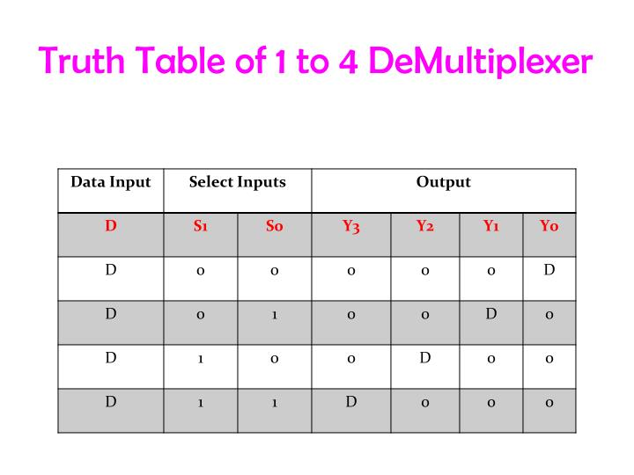

Slide 19
Applications of Multiplexer
Communication system – Communication system is a set of system that enable communication like transmission system, relay and tributary station, and communication network. The efficiency of communication system can be increased considerably using multiplexer. Multiplexer allow the process of transmitting different type of data such as audio, video at the same time using a single transmission line.
Computer Memory – A Multiplexer is used in computer memory to keep up a vast amount of memory in the computers, and also to decrease the number of copper lines necessary to connect the memory to other parts of the computer.

Slide 20
Applications of De-Multiplexer
Communication System - Communication system use multiplexer to carry multiple data like audio, video and other form of data using a single line for transmission. This process make the transmission easier. The demultiplexer receive the output signals of the multiplexer and converts them back to the original form of the data at the receiving end. The multiplexer and demultiplexer work together to carry out the process of transmission and reception of data in communication system.

Slide 21


